Slide 1
Occupant Loads
Select the appropriate number of people per exit
Determine the capacity of areas with merging flows

Slide 2
Historic Fire
Dusseldorf Airport

Slide 3
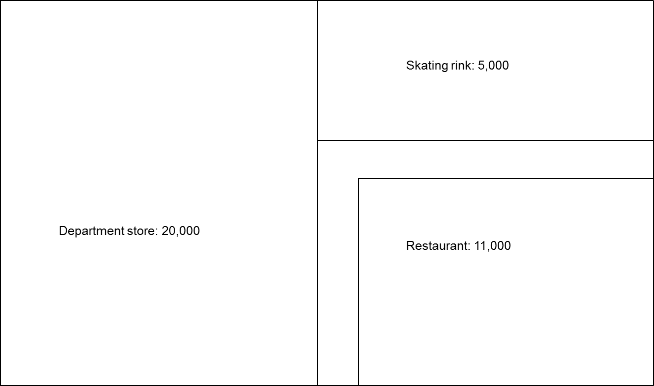
Assigning Exits

Slide 4
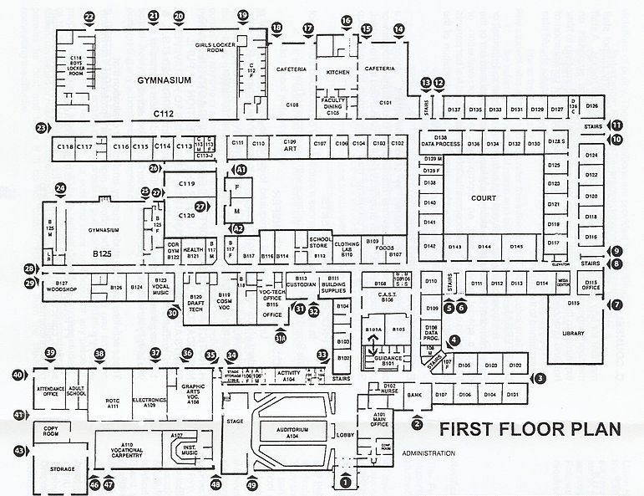
Simultaneous Occupancy

Slide 5
Evacuation Elevators
25 % population + 2 % wheelchairs

Slide 6

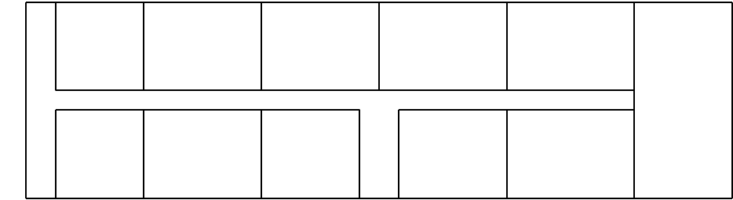
Merging Flows
Corridors
Stairs

Slide 7
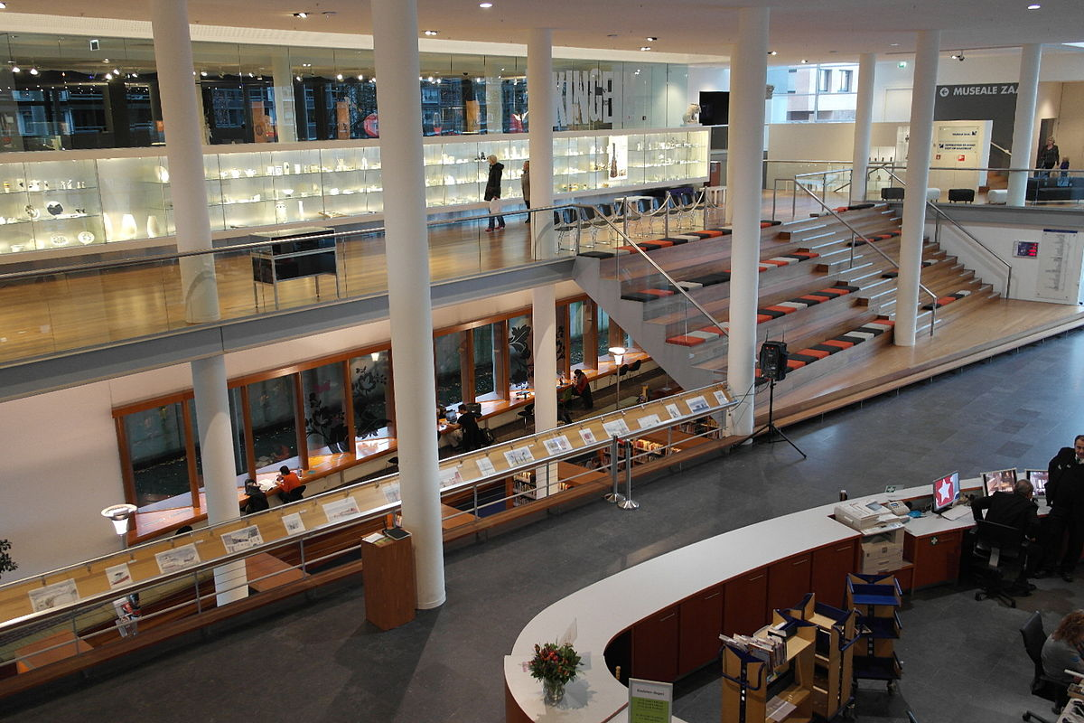
Balconies and Mezzanines

